Slide 1
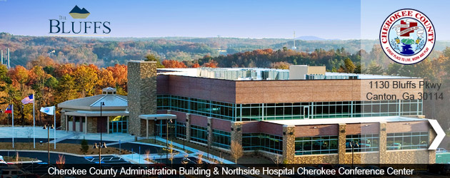
Millage Rate Public Hearings - 2010
Jerry W. Cooper, County Manager
Presented to Board of Commissioners

Slide 2
Cherokee County Property Tax Millage Rate Public Hearing Property Taxes in Cherokee County
2nd Lowest General Millage Rate in the State of Georgia – Current 2009 Rates
Forsyth County currently has the lowest General M&O property tax rate due to a Local Option Sales Tax (LOST) used to rollback property taxes, but announced a proposed increase in their General M&O property tax rate from 3.834 to 5.429, and an increase in their Fire District rate from 1.841 to 1.975.
Gwinnett County recently increased property taxes 21%.
Douglas County recently announced 19% increase in property taxes
No property tax rate increase for General operations since 1996, which has resulted in tax savings to property owners of over $100 million.
2009 and 2010 budgets cut $30 million: General and Fire operations cut $4.3 million; Sales tax cut $20 million; Impact Fees cut $5.7 million
Property tax revenue funds 67% of general operations and 92% of fire operations
Property values declined 8.35% this year, resulting in $4.5 million loss of revenue that will impact the 2011 budget

Slide 3
Cherokee County Property Tax Millage Rate Public Hearing Future Fiscal Challenges
Estimated $2 million shortfall in employee health care
Health care plan changes, including modifications to rates, will be necessary to cover shortfall.
County jail inmate health services cost estimated to increase $250,000+ in 2011.
Operating cash has declined nearly $7 million in two (2) years
Property values projected to decline in 2011
General Fund and Fire District Funds heavily dependent on property tax revenue to fund operations. Should Local Option Sales Tax (LOST) to diversify revenue sources be considered
State unfunded/underfunding mandates total $12 million in 2010
Includes local tax payers paying for state agencies and mandated services. Housing state prisoners costs $1.2 million; $2 million indigent defense costs; $2 million lost in Medicaid payments for EMS; $6 million to subsidize state agencies

Slide 4
Fiscal Responsibility General Fund
Lowered general property taxes from 6.990 In 1996 to proposed 4.729 in 2010.
Highest S&P Investment Services rating in county history: AA+
2nd Lowest # Employees Per Capita in Metro-Atlanta
Cut millions from budget without impacting service levels
Proposal to increase rate from 4.381 to 4.729

Slide 5
Fiscal Responsibility Fire District
Awarded #1 EMS Agency in Georgia - 2009
Fire Department Insurance Service Office (ISO) rating of 5/9. Only 23% of all fire departments in country rated 5 or lower (1=Best 10=Worst)
Proposed millage rate increase from 2.742 to 2.956 mills

Slide 6
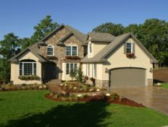
Increase in property tax rates, but NOT an increase in dollars.
The purpose of this millage rate increase is to attempt to collect the same amount in 2011 as collected in 2010…
$200,000 property value
7.703 millage rate
$616 property tax
$183,300 property value*
8.313 millage rate
$616 property tax
Same level of county services as prior year
=
*Note: Based on 8.35% deflation in property values

Slide 7
State of the Economy
Unemployment: 2008 (3.8%) 2009 (6.9%) 2010 (9.2%)
While the Metro Region lost over 96,000 jobs from 2000 to 2009, Cherokee gained nearly 8,500. Fulton County Lost 29,000 and Gwinnett Lost 27,000 jobs.
Building Permits dropped from 3,358 in 2007 to 1,887 in 2009 – a 43.8% decline. May permits increased from 162 in 2009 compared to 211 in 2010 - a 31% increase.
Property Values declined 8.35% from 2009 to 2010, resulting in a $4.5 million loss in revenue, and projected to decline 7.7% from 2008 through 2011.
2008 8,647,647,873 +05.0%
2009 8,363,820,840 -03.3%
2010 7,665,066,175 -08.4%
2011 7,593,734,625 -01.0% -7.70%

Slide 8
Cherokee County A Great Place to Live, Work and Play
Questions?
Jerry W. Cooper, County Manager
County Administration Building & Conference Center
1130 Bluffs Parkway
Canton, GA 30114
678-493-6001 office
jcooper@cherokeega.com

